Slide 1

Mahindra First Choice Services Report
Created by:
Rakesh Kedar
Pancham Desai
Vedant Thapa
Siddhesh Gupta
Team 2

Slide 2
Problem Statement
Geo location Based Analysis
Generate meaningful insights on Geolocation based customer & revenue analysis
Market Segmentation
Divide the customer base into segments based on their car type, service type & total spend such that these customers will respond similarly to the different marketing campaigns.
Customer Lifetime Value Prediction
Life time value analysis of customers to maintain relationship with high profit generating customers in future & finding potential customers from the population.

Slide 3
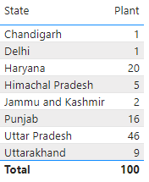
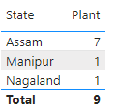
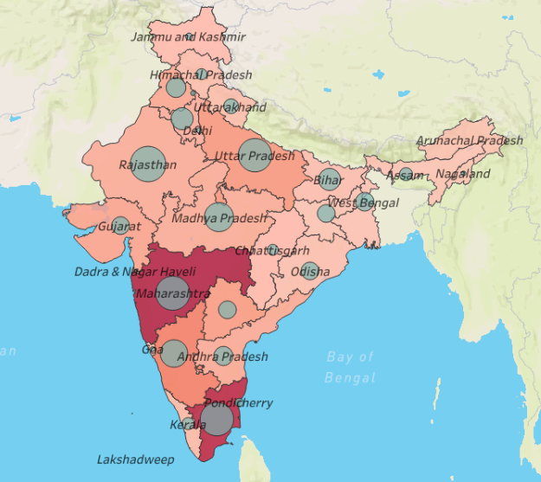
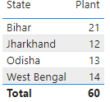
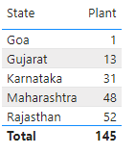
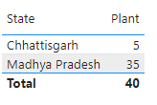
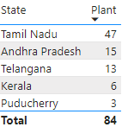
Customer & Plant Analysis

Slide 4
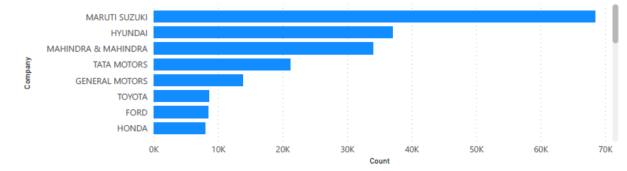
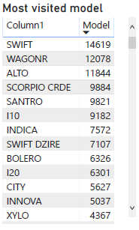
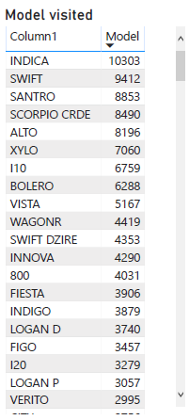
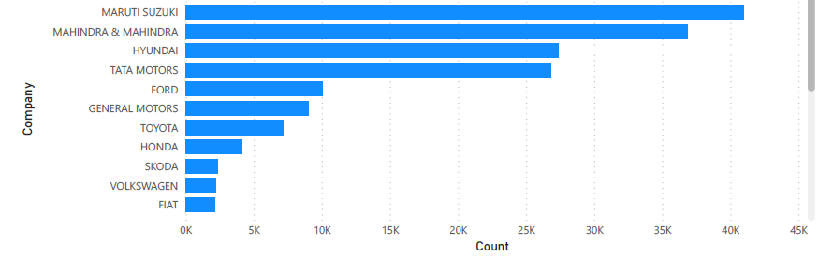
Most visited Cars Companies in Different Zones
Western Zone :
Total Car Companies: 28
Total No. of Car visited to workshop: 211K
Southern Zone
Total Car Companies: 26
Total No. of Car visited to workshop: 172K

Slide 5
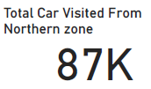
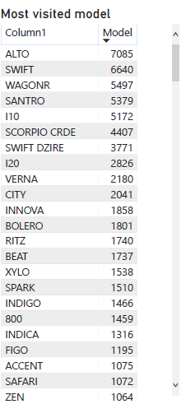

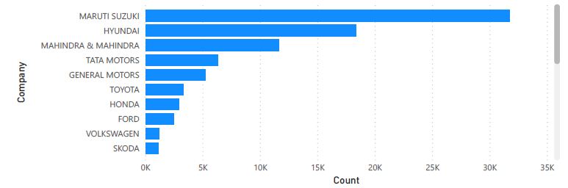
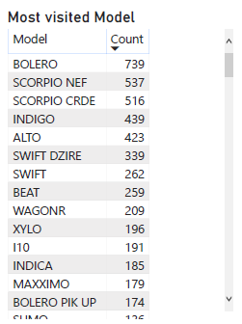


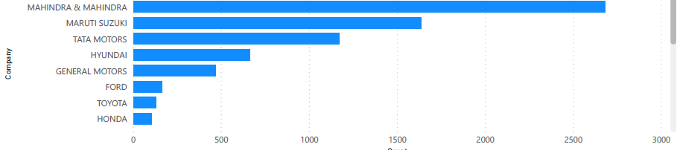
Northern Zone:
Top 10 Companies
Eastern Zone:
Top 8 Companies

Slide 6
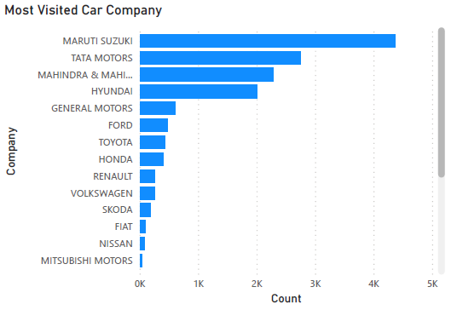
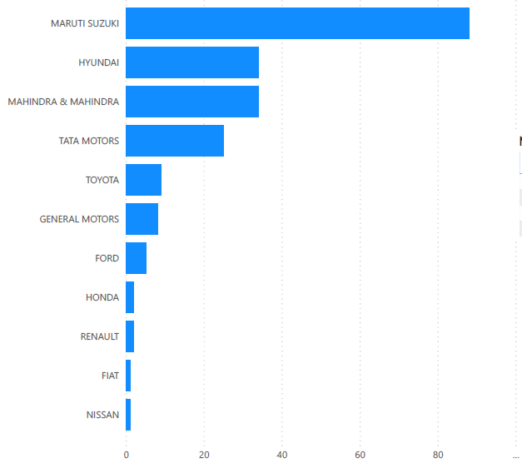
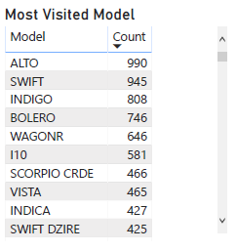
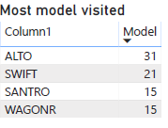
Northeastern Zone :
Central Zone :
Total Car Companies: 23
Total Car Companies: 11
Total No. of Car visited:14K
Total No. of Car visited:209
company
Count

Slide 7
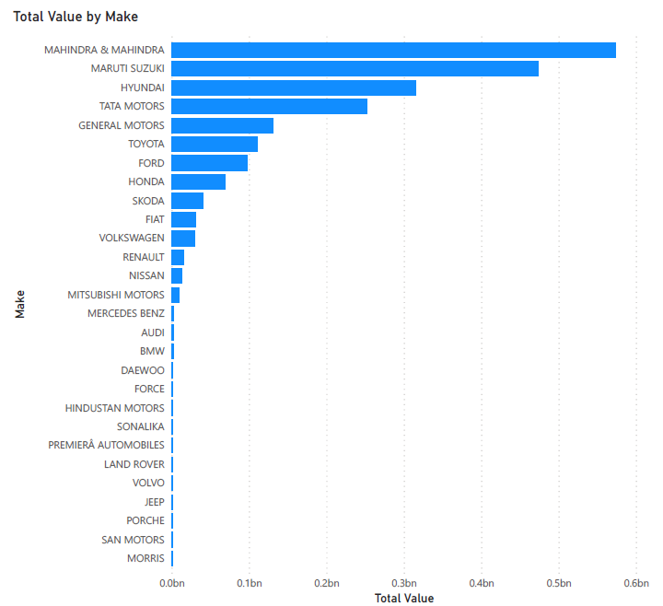

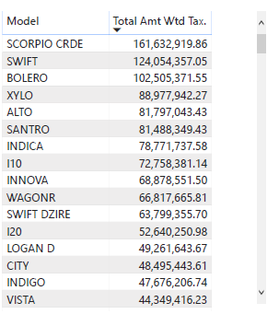
Revenue Based on Make and Model
Total Revenue

Slide 8
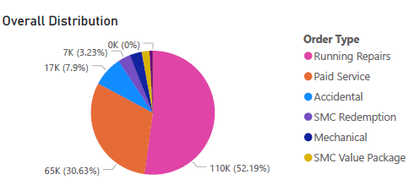
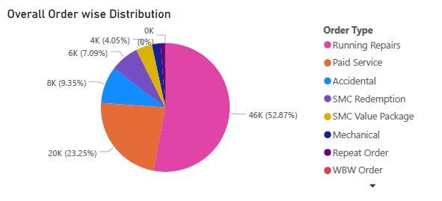
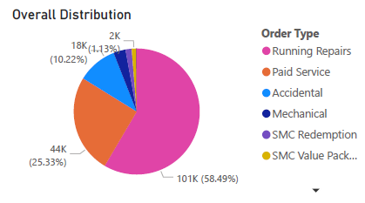
Different Kinds of Orders Zones Receive
Western Zone :
Northern Zone:
Southern Zone

Slide 9
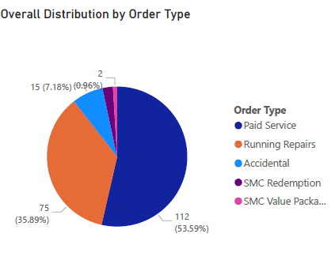
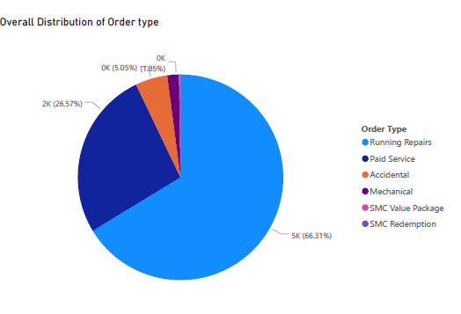
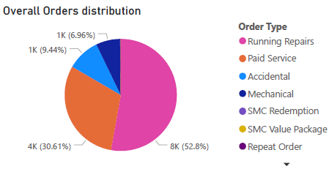
Northeastern Zone :
Eastern Zone :
Central Zone :

Slide 10
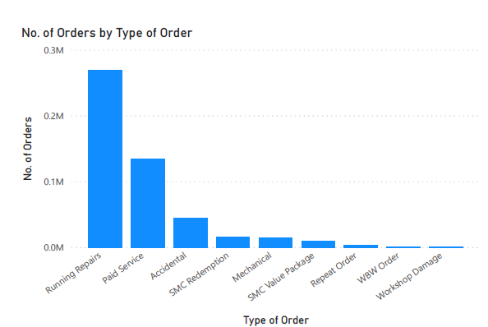
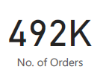
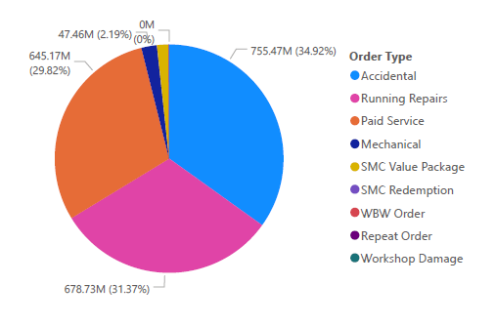
Revenue Based On Order Type
Total Revenue

Slide 11
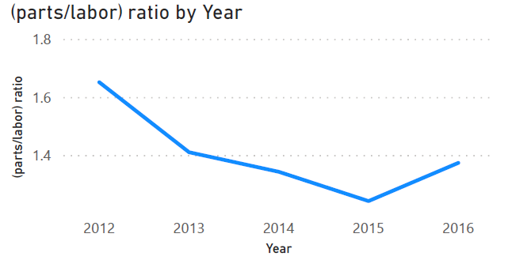
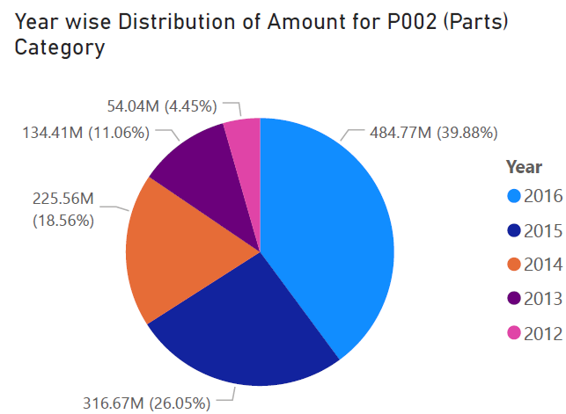
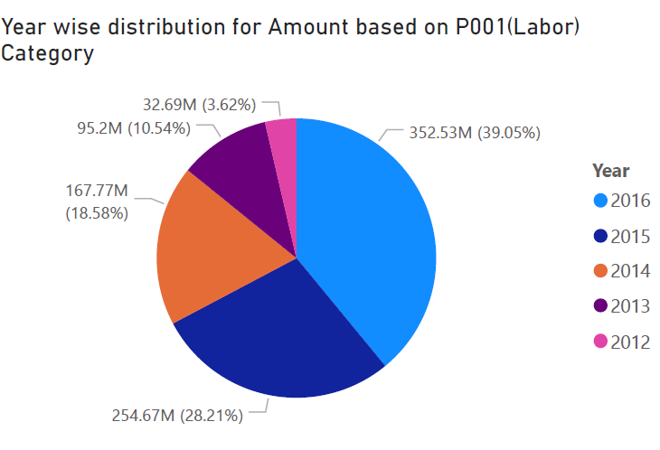
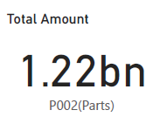
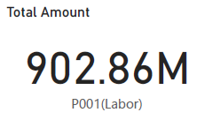
Parts To Labor Ratio

Slide 12
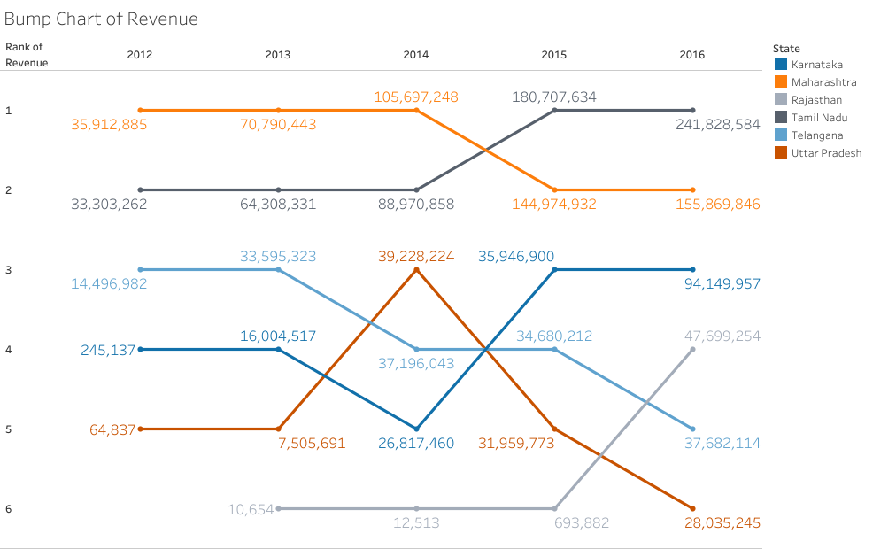
State wise Trend In Revenue

Slide 13

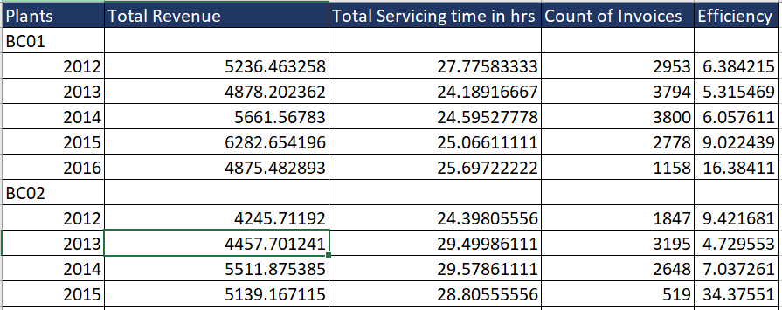
Efficiency Of A Plant
Efficiency was calculated Plant wise for each year & each month
Efficiency = (Total Revenue in a year / Total servicing time in hrs * Count of invoices) *100

Slide 14
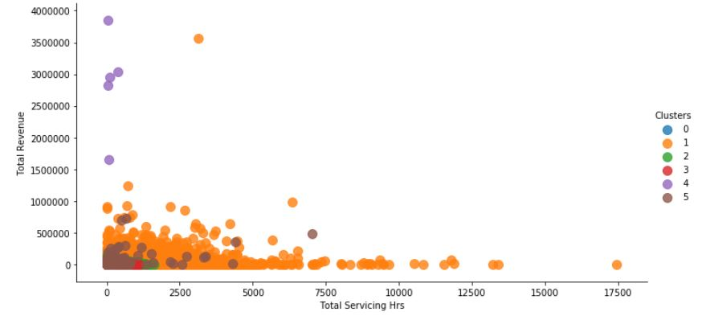
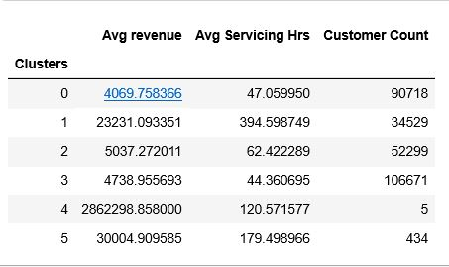
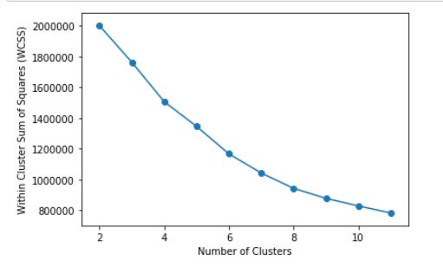
Market Segmentation

Slide 15
Cust Type | Average revenue | Average Servicing Hrs | Customers Count
0 | 5033 | 54 | 90718
Insurance | 4235 | 49 | 1
MFCWL | 6796 | 66 | 41
Retail | 4069 | 47 | 90676
1 | 15160 | 263 | 34529
MFCWL | 7085 | 131 | 10
Retail | 23236 | 395 | 34519
2 | 6212 | 74 | 52299
MFCWL | 7388 | 85 | 22
Retail | 5036 | 62 | 52277
3 | 6635 | 56 | 106671
MFCWL | 8533 | 68 | 40
Retail | 4738 | 44 | 106631
4 | 2941186 | 107 | 5
Fleets | 3335623 | 38 | 2
Retail | 2546749 | 176 | 3
5 | 25445 | 184 | 434
Corporate- M&M | 39127 | 207 | 73
Corporate others | 25047 | 149 | 173
Fleets | 32319 | 197 | 179
Franchise | 5285 | 184 | 9
Grand Total | 403684 | 127 | 284656

Slide 16
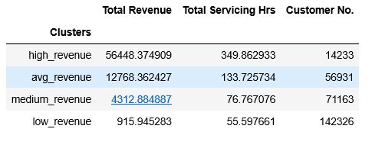
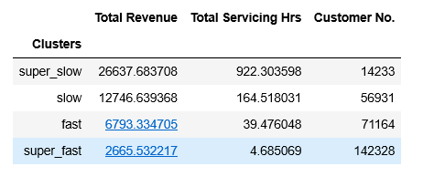
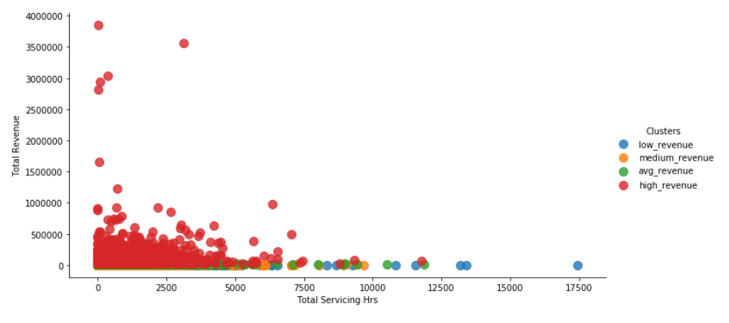
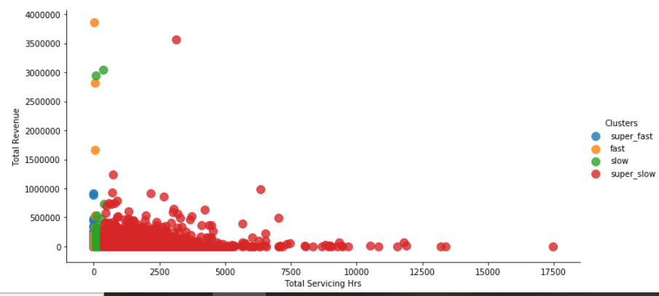
Rule Based Clustering

Slide 17
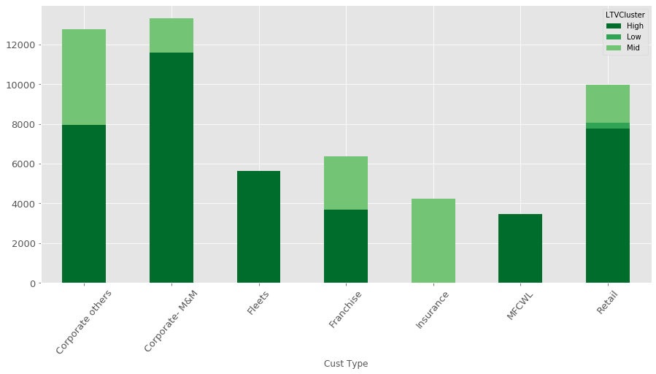
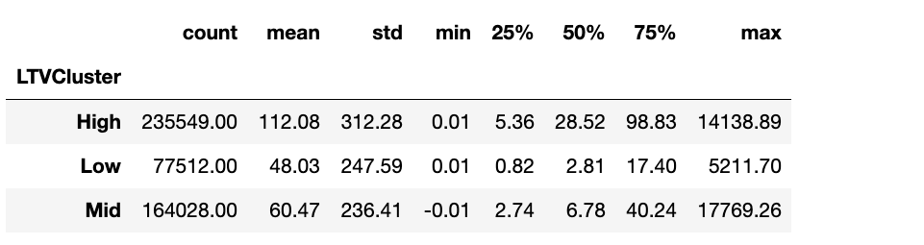

Slide 18
Customer Life Time Value Prediction
Customer lifetime value is a metric that indicates the total revenue a business can reasonably expect from a single customer account.
It is calculated as Average purchase frequency multiplied by Average spend per visit.
Considered 2015 year data.
Business can use this metric to increase ROI.

Slide 19
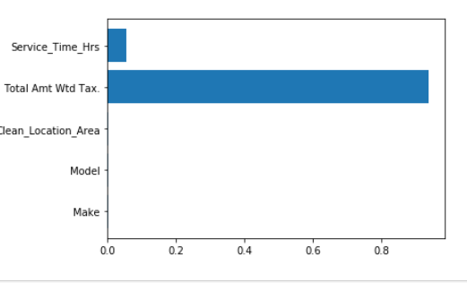
Model Evaluation
Classification Output - Low Ltv Group (<3036)
Medium Ltv Group( 3036 & 8801 )
High Ltv Group (>8801)
Regression Output - Continuous LTV value
Model | Cross val Score
Decision Tree Regressor | 0.88
Decision Tree Classifier | 0.83
Random Forest Classifier | 0.81
XGB classifier | 0.81

Slide 20
Conclusion
Investigate what are the reasons for decrease in revenue in the Plants present in state of Telangana , Uttar Pradesh .
Spare parts of Indian Brands must be stocked up inventory. Since maximum no. of cars visited Mahindra first choice are of Indian brands
The large share of revenue is from accidental cases. And Service time required is also more . Cars of brands Maruti Suzuki , Hyundai and Mahindra are present most in accidental cases. Spare parts of this cars must be present in stock. So the service time is reduce
Most of the customers coming to Mahindra first choice services are from retail background hence special attention must be given to them
The customer strength of Maharashtra and Tamilnadu is very good. Similar kind of improvement in customer strength should attained in all other states.
Please take feedback from Customers after service is given in for example (rating out of 5). Since it can be used to find the quality of service

